Slide 1

7th Grade Math
Unit 1, Lesson 2 Ratio Relationships Volume 1, pg.10

Slide 2


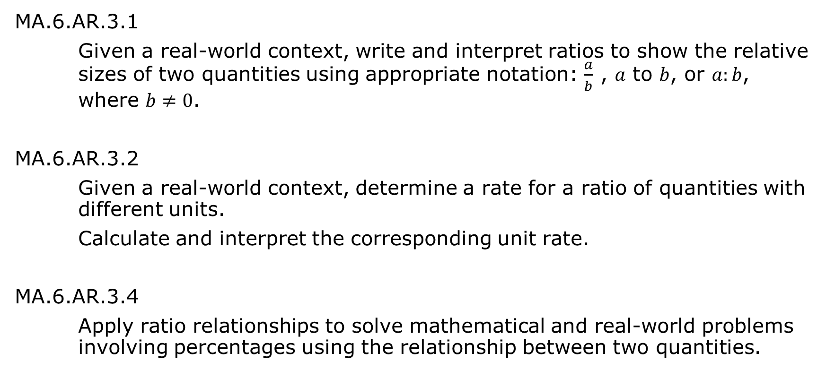
Benchmarks
MA.6.AR.3.1
Given a real-world context, write and interpret ratios to show the relative sizes of two quantities using appropriate notation: $\frac{a}{b}$ , $a$ to $b$, or $a:b$, where $b≠0$.
MA.6.AR.3.2
Given a real-world context, determine a rate for a ratio of quantities with different units.
Calculate and interpret the corresponding unit rate.
MA.6.AR.3.4
Apply ratio relationships to solve mathematical and real-world problems involving percentages using the relationship between two quantities.
volume 1, pg. 10

Slide 3
Integrated Mathematical Thinking and Reasoning Standards
MA.K12.MTR.2.1 Demonstrate understanding by representing problems in multiple ways.
MA.K12.MTR.4.1 Engage in discussions that reflect on the mathematical thinking of self and others.
volume 1, pg. 10

Slide 4

Learning Targets
I can interpret ratios when given multiple representations.
I can solve real-world problems involving ratios.
volume 1, pg. 10

Slide 5

Warm-Up
volume 1, pg. 10

Slide 6
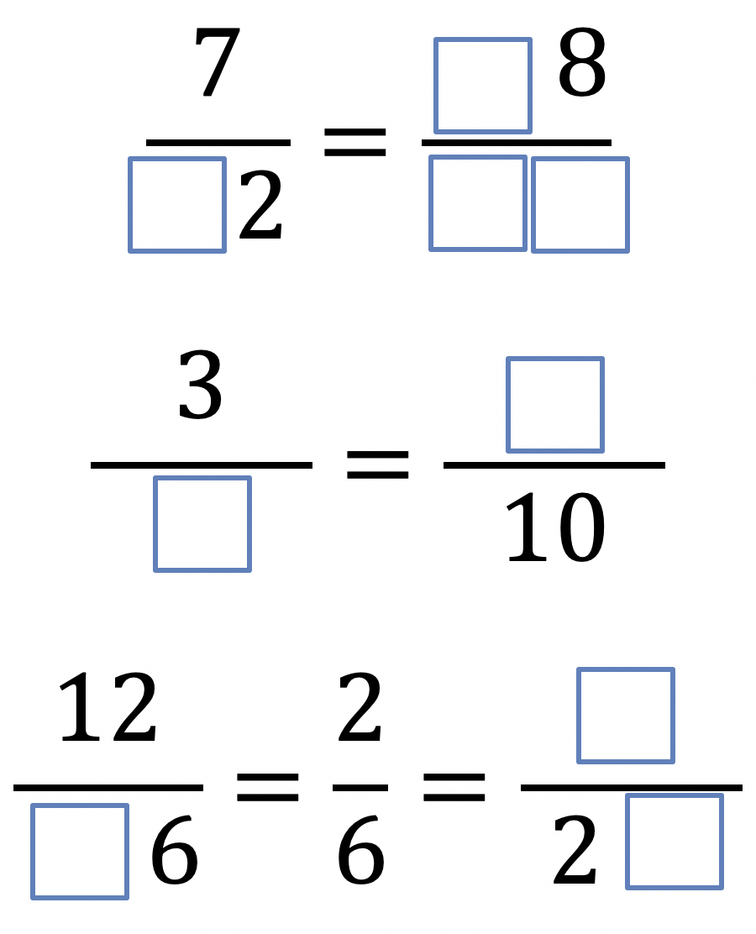
1.2.1 Warm-Up: Equivalent Fractions
Using the digits 1 to 9 once each, fill the boxes so that the three equations show equivalent fractions.
volume 1, pg. 10

Slide 7

Refresher
volume 1, pg. 11

Slide 8


1.2.2 Refresher: Reading and Writing Ratios
The Florida Gators are experimenting with creating a new flavor of Gatorade, Gatormax. To create Gatormax, they will mix the following ratio of red and blue Gatorade together.
volume 1, pg. 11

Slide 9
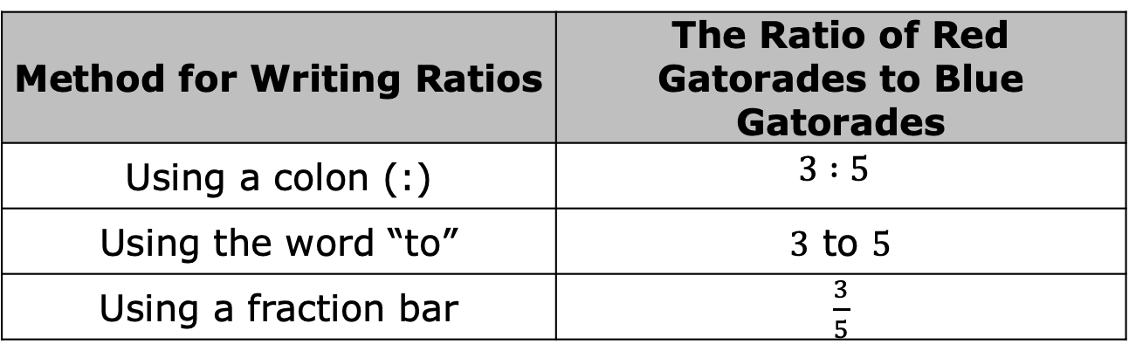
Complete the statement.
There are ____ red Gatorades for every ____ blue
Gatorades in Gatormax.
There are three ways to express ratios.
Write the ratio of blue Gatorades to total Gatorades in three ways.
Method for Writing Ratios | The Ratio of Red Gatorades to Blue Gatorades
Using a colon (:) | $$3 :5$$
Using the word “to” | $3$ to $5$
Using a fraction bar | $\frac{3}{5}$
volume 1, pg. 11

Slide 10

Guided Practice
volume 1, pg. 11

Slide 11

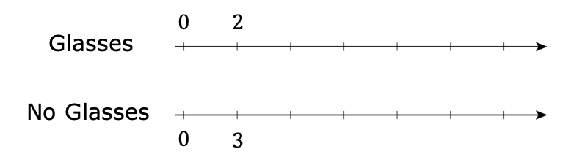
1.2.3 Guided Practice: Representing Ratio Relationships
The ratio of the number of students who wear glasses to the number of students who do not is $2:3$.
Complete the double number line for this ratio.
If $18$ students in the class do not wear glasses, how many students are in the class?
volume 1, pg. 11

Slide 12
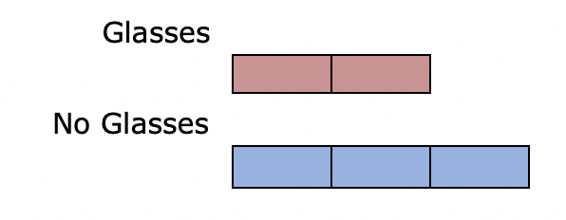
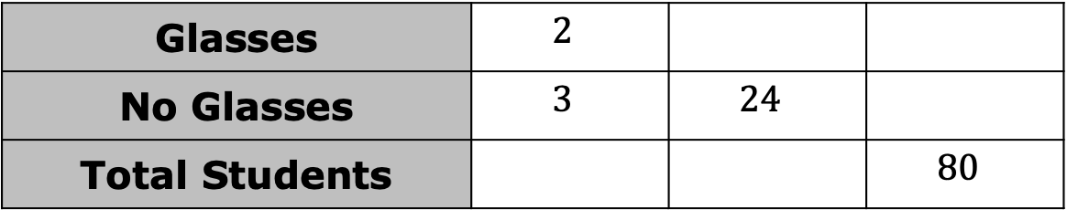

Use the tape diagram to determine how many students do not wear glasses given that there are $25$ students in the class.
Complete the table.
Glasses | $$2$$
No Glasses | $$3$$ | $$24$$
Total Students |  |  | $$80$$
volume 1, pg. 11

Slide 13

Collaboration
volume 1, pg. 12

Slide 14

1.2.4 Collaboration: Rates and Unit Rates
Four students work as baristas after school. They all start out with the same pay per hour. During the first year of employment, the baristas earn a $0.05 per hour raise in pay each month. Work with your partner to complete the following questions.
Use the relationship between the number of hours worked and the amount of money earned to complete the table.
volume 1, pg. 12

Slide 15
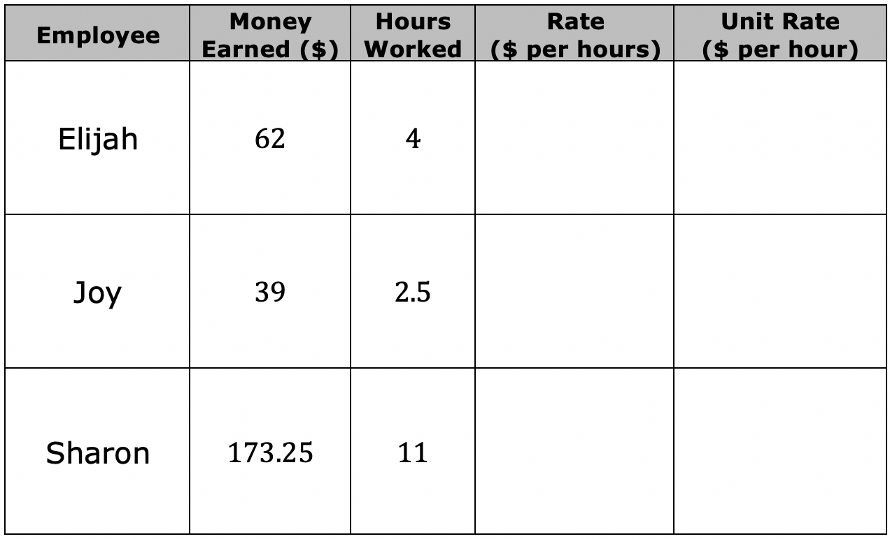
volume 1, pg. 12

Slide 16
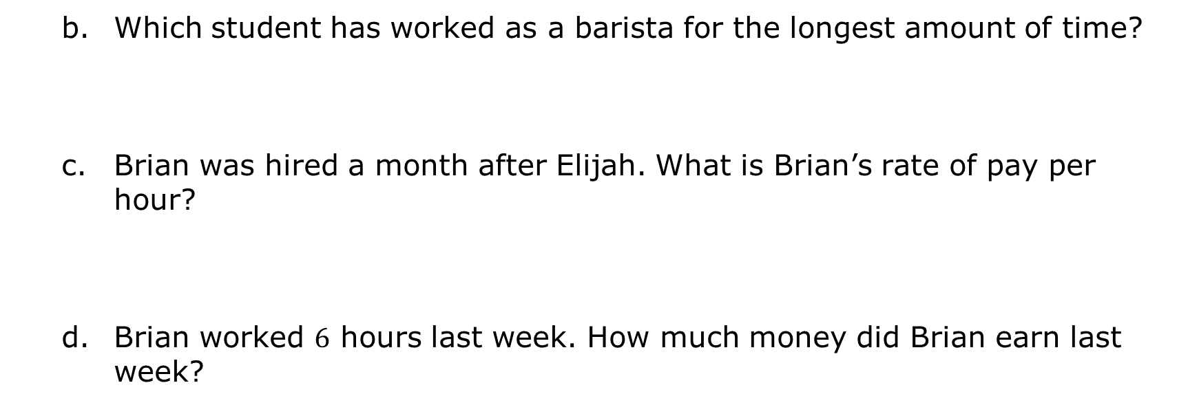
Which student has worked as a barista for the longest amount of time?
Brian was hired a month after Elijah. What is Brian’s rate of pay per hour?
Brian worked $6$ hours last week. How much money did Brian earn last week?
volume 1, pg. 12

Slide 17
Guided Practice
volume 1, pg. 12

Slide 18
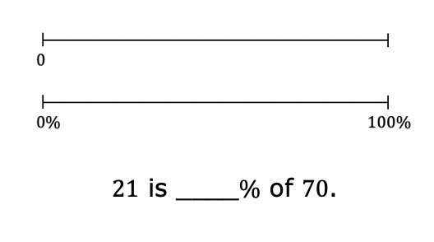
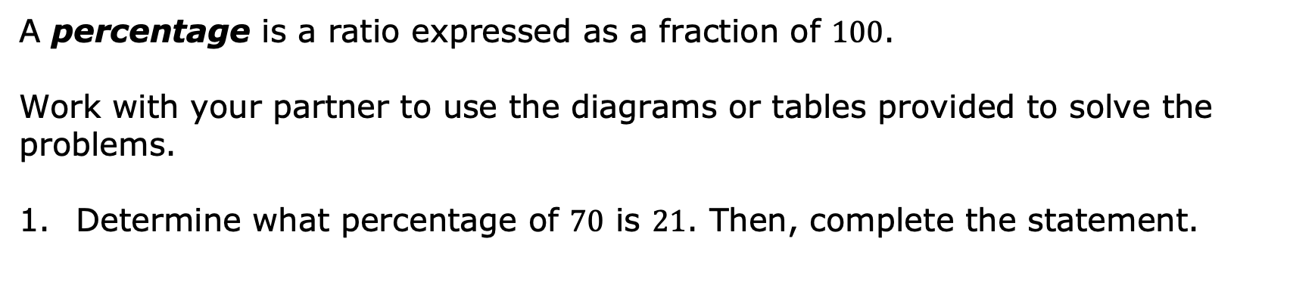
1.2.5 Guided Practice: Applying Ratios to Percentages
A percentage is a ratio expressed as a fraction of $100$.
Work with your partner to use the diagrams or tables provided to solve the problems.
Determine what percentage of $70$ is $21$. Then, complete the statement.
volume 1, pg. 12

Slide 19
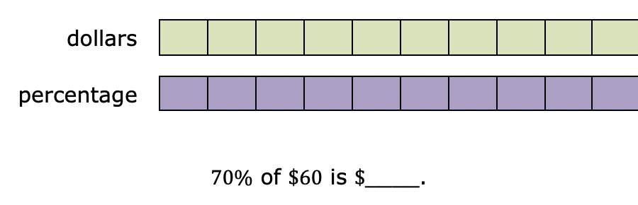
Determine $70\%$ of $\$60$. Then, complete the statement.
volume 1, pg. 12

Slide 20
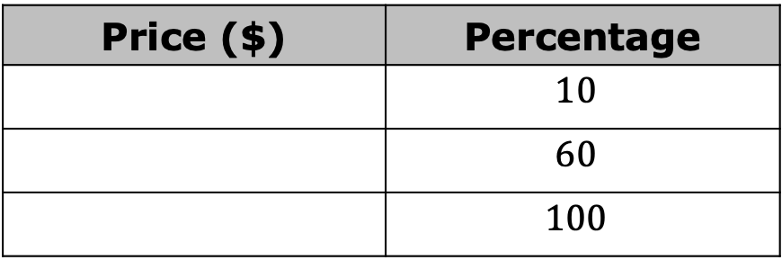
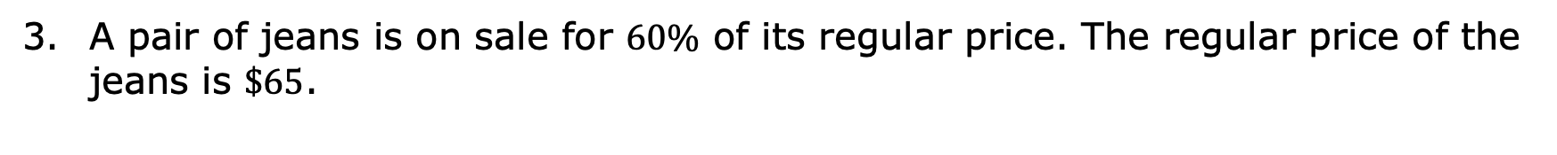
A pair of jeans is on sale for $60\%$ of its regular price. The regular price of the jeans is $\$65$.
Complete the ratio table to determine the sale price.
Complete the statement.
The sale price of the jeans is $________.
Price ($) | Percentage
 | $$10$$
 | $$60$$
 | $$100$$
volume 1, pg. 13

Slide 21

Wrap-Up
volume 1, pg. 13

Slide 22
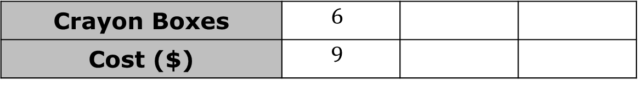

1.2.6 Wrap-Up: Ticket Out the Door
The table shows the cost of boxes of crayons at a convenience store.
Use the ratio table to find the cost of $15$ boxes of crayons.
Find the unit rate in dollars per box.
Crayon Boxes | $$6$$
Cost ($) | $$9$$
volume 1, pg. 13

Slide 23
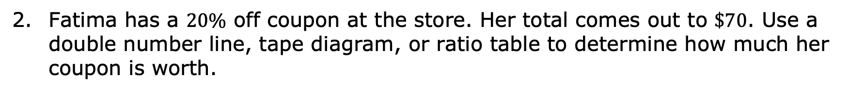
Fatima has a $20\%$ off coupon at the store. Her total comes out to $\$70$. Use a double number line, tape diagram, or ratio table to determine how much her coupon is worth.
volume 1, pg. 13

